Slide 1

It is All About the Data Preprocessing, Manipulation
Dr. Roni Ramon-Gonen

Slide 2
The Data Mining Purpose
Define purpose
Obtain data
Preprocess: Explore & clean data
Determine data mining (DM) task
Choose DM method
Apply methods & select final method
Evaluate performance
Deploy

Slide 3
In this session
Common functions to handle data
Data used: IMDB datasets:
IMDB_movies.csv
IMDB_players.csv

Slide 4
Plan
Read data
Summary statistics
Data imputation
Descriptive Statistics and Pivoting
Merging datasets
Sampling
Data partition

Slide 5
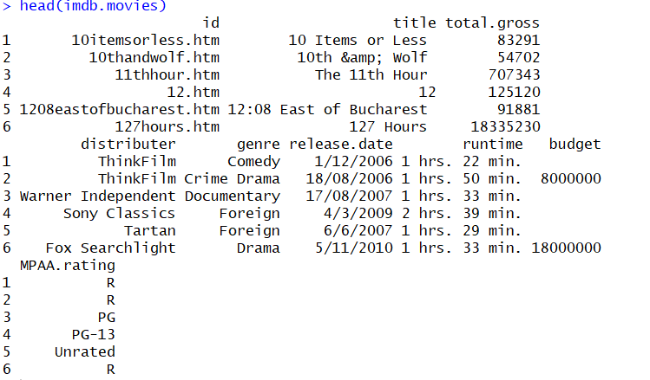
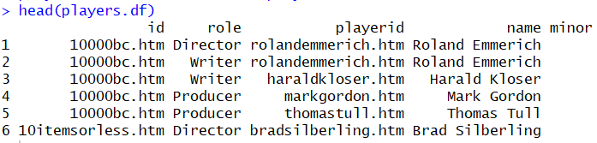
Let Us Dive: IMDB Data
Contains 2 datasets:
IMDB Movies – list of movies, with total gross as the predictor variable
IMDB Players – list of role players per movie

Slide 6

Read the data
## do not forget to set working directory
setwd(YOUR DIRECTORY)
imdb.movies <- read.csv("IMDB_movies.csv")
head(imdb.movies)
players.df <- read.csv("IMDB_players.csv")
head(players.df)

Slide 7
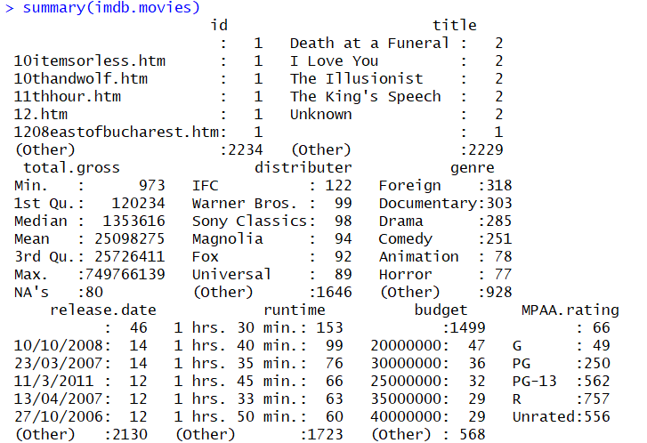
Summary statistics

Slide 8
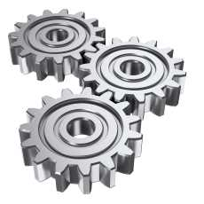
Data Preprocessing

Slide 9
Remove missing values: total.gross
Remove entire row
imdb.movies.nomissing <-
imdb.movies[is.na(imdb.movies$total.gross) == FALSE, ]

Slide 10

Data imputation
Replace missing values/ outliers with mean/ median/ other
imdb.movies$total.gross[is.na(imdb.movies$total.gross)] <-
mean(imdb.movies$total.gross, na.rm = TRUE)

Slide 11
Preprocessing Budget
## budget class
summary(imdb.movies$budget)
class(imdb.movies$budget)
imdb.movies$budget <- as.numeric(as.character(imdb.movies$budget))
## create new variable
imdb.movies$budgetAvil <- is.na(imdb.movies$budget)
Notes:
Filter:
Can filter rows/ columns
Remove null/ outlier observations
Use subset of the data
Sample:
Partition
Bootstrap
Cross validation

Slide 12
Descriptive statistics: data aggregation
Compute counts, mean, stdev, and more
3 useful functions:
table – compute counts
aggregate – aggregate by desired function
Functions melt and cast (library reshape) – to generate “pivot tables” (will not show in class)

Slide 13
Code for aggregation
# table: counts - number of movies per genre
table(imdb.movies$genre)
# function "aggregate" - simple aggregation function
# mean gross per genre
aggregate(total.gross ~ genre, data = imdb.movies, FUN = "mean")

Slide 14
Do it yourself
Compute number of directors per movie (use function “table”)
Convert the result to data.frame called "numDirectors.df“
Label the columns in the data frame: "id", "numDir“

Slide 15
Aggregation: code
numDirectors <- table(players.df[players.df$role == "Director",]$id)
numDirectors.df <- as.data.frame(numDirectors)
names(numDirectors.df) <- c("id", "numDir")

Slide 16
Merging files
Merge two datasets by id
merge(imdb.movies, numDirectors.df,
by.x = "id",
by.y = "id",
all = T)

Slide 17
Data partitioning

Slide 18
Data Partition
Key question in predictive analytics:
How well will our prediction or classification model perform when we apply it to new data?
→ make sure that our model generalizes beyond the dataset that we have at hand

Slide 19
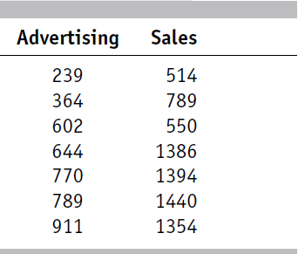
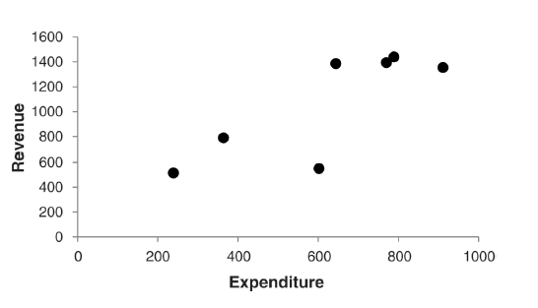
Overfitting
The more variables we include in a model, the greater the risk of overfitting the particular data used for modeling.
Example: Sales as a function of advertisement expenditures

Slide 20
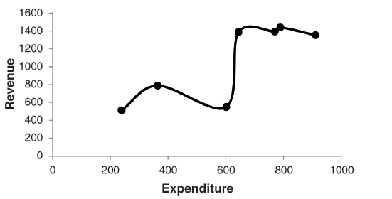
Overfitting – cont’
No error (residual) model: fit a complex function to Sales ~ Expenditures
Will it be accurate for future sales?

Slide 21
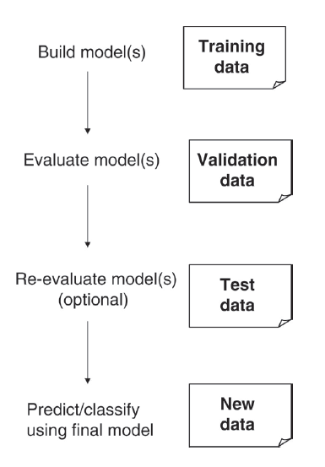
Building a Model
Build model on training,
Evaluate on validation.
Deploy on real data.

Slide 22
Partition in R
# use set.seed() to get the same partitions when re-running the R code.
set.seed(1)
## partitioning into training (60%) and validation (40%)
# randomly sample 60% of the row IDs for training; the remaining 40% serve as validation
train.rows <- sample(1:dim(imdb.movies)[1], dim(imdb.movies)[1]*0.6)
# collect all the columns with training row ID into training set:
train.data <- imdb.movies[train.rows, ]
# assign row IDs that are not already in the training set, into validation
valid.data <- imdb.movies[-train.rows, ]

Slide 23
Cross Validation
An alternative to data partitioning is cross-validation:
Start with partitioning the data into “folds”: non-overlapping subsamples.
Example: k=5 folds, meaning that the data are randomly partitioned into 5 equal parts, where each fold has 20% of the observations.
Fit the model k times. Each time, one of the folds is used as the validation set and the remaining k-1 folds serve as the training set.
Aggregate performance measure.
Implemented in some statistical methods in R.
Fold 1 | Fold 2 | Fold 3 | Fold 4 | Fold 5

Slide 24
Cross Validation
An alternative to data partitioning is cross-validation:
Start with partitioning the data into “folds”: non-overlapping subsamples.
Example: k=5 folds, meaning that the data are randomly partitioned into 5 equal parts, where each fold has 20% of the observations.
Fit the model k times. Each time, one of the folds is used as the validation set and the remaining k-1 folds serve as the training set.
Aggregate performance measure.
Implemented in some statistical methods in R.
Fold 1 | Fold 2 | Fold 3 | Fold 4 | Fold 5
Training
Validation

